Slide 1
Introduction to Machine Learning and the Applications in Motion Planning

Slide 2
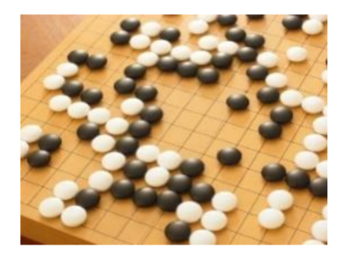




Machine Learning $≈$ Looking for a Function
Playing Go
$f($ $)=$ “5-5” (next move)
Control a Robot
$f($ $)=u1, u2, …$ (next control signals)
Notes:
机器学习到底在做什么 可以做什么？

Slide 3
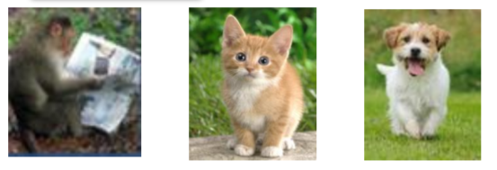
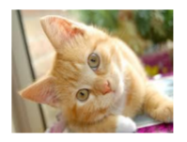
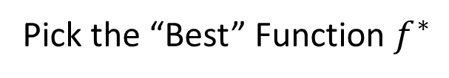
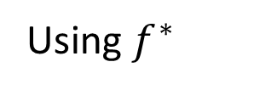
Framework of Machine Learning
Training
Testing
Model
A set of function
“cat”
Pick the “Best” Function $f^{∗}$
Goodness of function f
Using $f^{∗}$
Training Data
“monkey” “cat” “dog”
Notes:
机器学习一般是怎么样“学”的
Suppose we are tackling with am image recognition task

Slide 4
Machine Learning is very simple
Step 1: define a set of function
Step2: goodness of function
Step3: pick the best function
Notes:
总结一下就是分三步: 所有可能的模型，定义什么样的模型是一个好模型， 想办法找到最好的那个

Slide 5

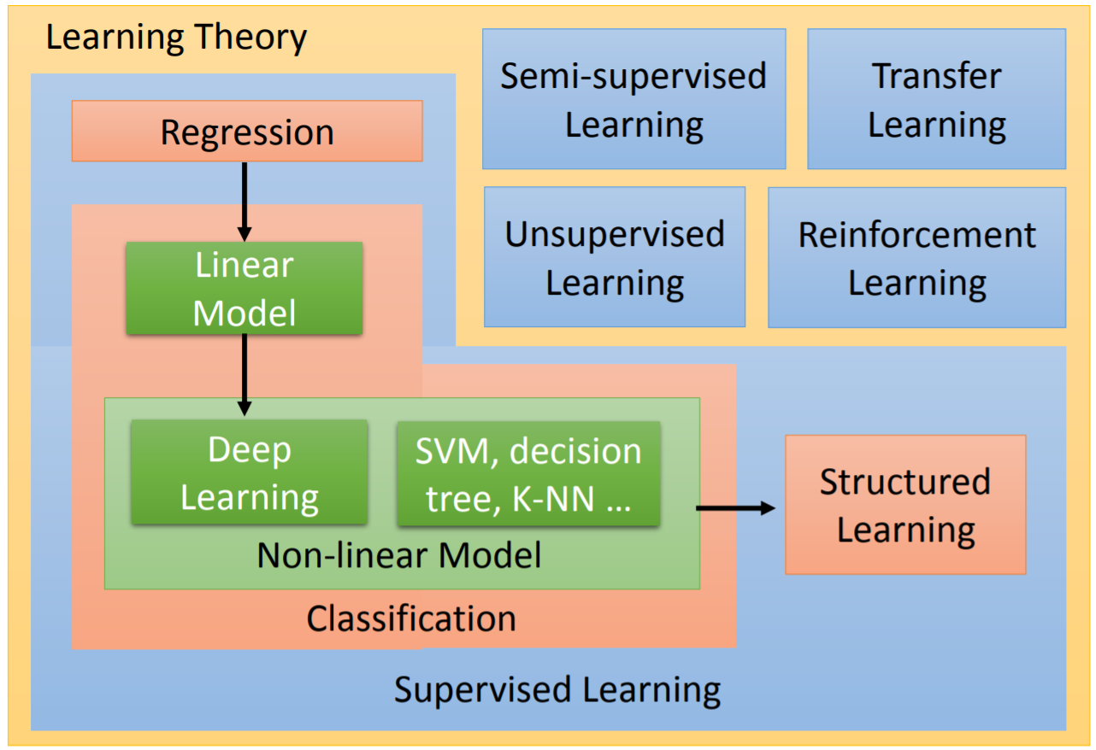
Learning Map
Notes:
不同性质场景对应不同的方法
不同的任务对应不同的算法
每种回归、分类或是结构性表达都可以用线性模型、非线性模型

Slide 6
Regression Problem
Linear regression
Trivial
Use Deep Learning to solve nonlinear regression
Powerful Tool

Slide 7
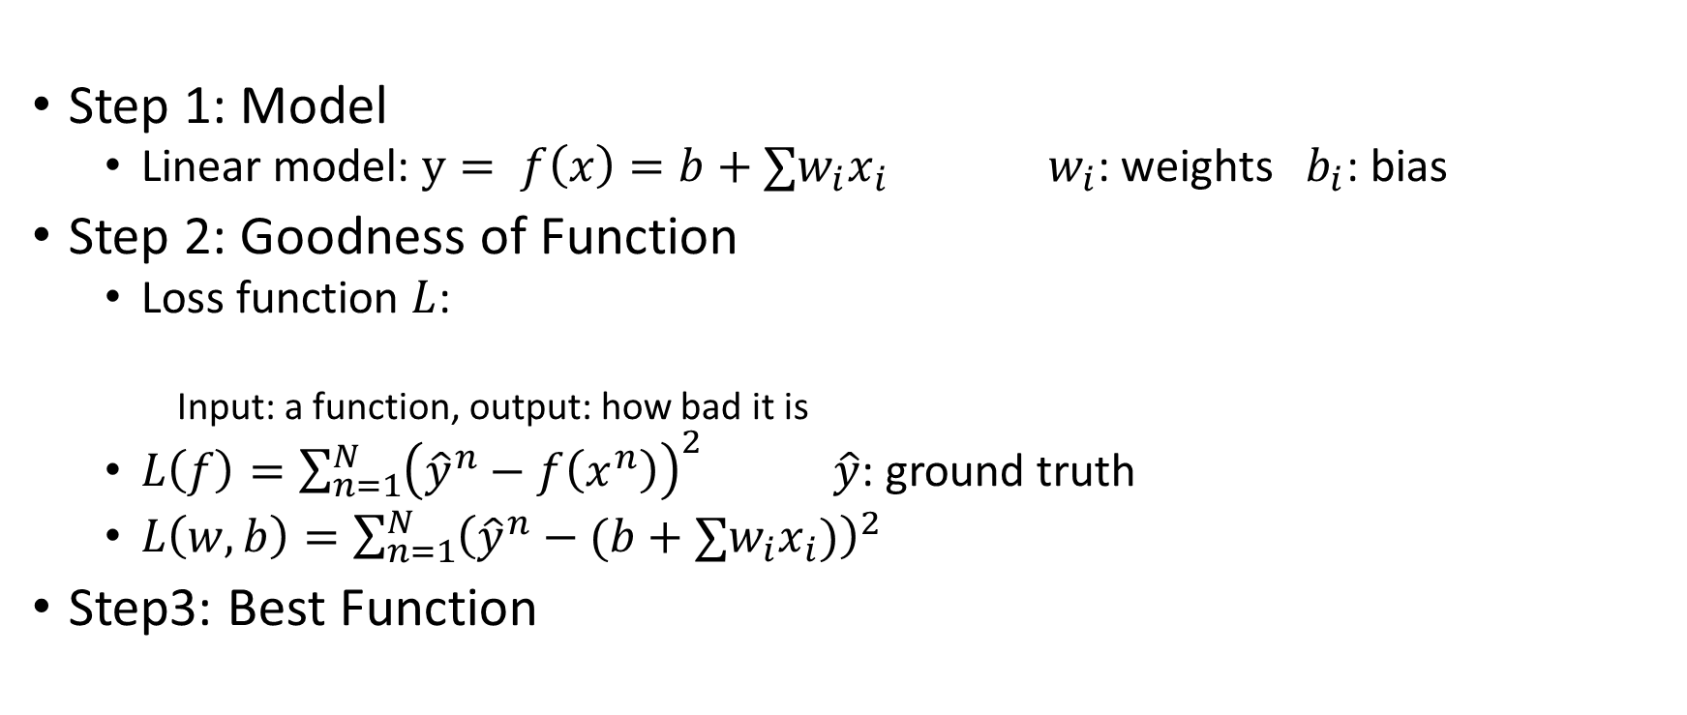
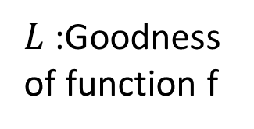
Linear Regression
A set of function
Step 1: Model
Linear model: $y= f\left(x\right)=b+∑w_{i}x_{i}$ $w_{i}$: weights $b_{i}$: bias
Step 2: Goodness of Function
Loss function $L$:
Input: a function, output: how bad it is
$L\left(f\right)=\sum_{n=1}^{N}{{\left({\hat{y}}^{n}−f\left(x^{n}\right)\right)}^{2}}$ $\hat{y}$: ground truth
$L\left(w, b\right)=\sum_{n=1}^{N}{{\left({\hat{y}}^{n}−(b+∑w_{i}x_{i})\right)}^{2}}$
Step3: Best Function
$L$:Goodness of function f
Training Data

Slide 8
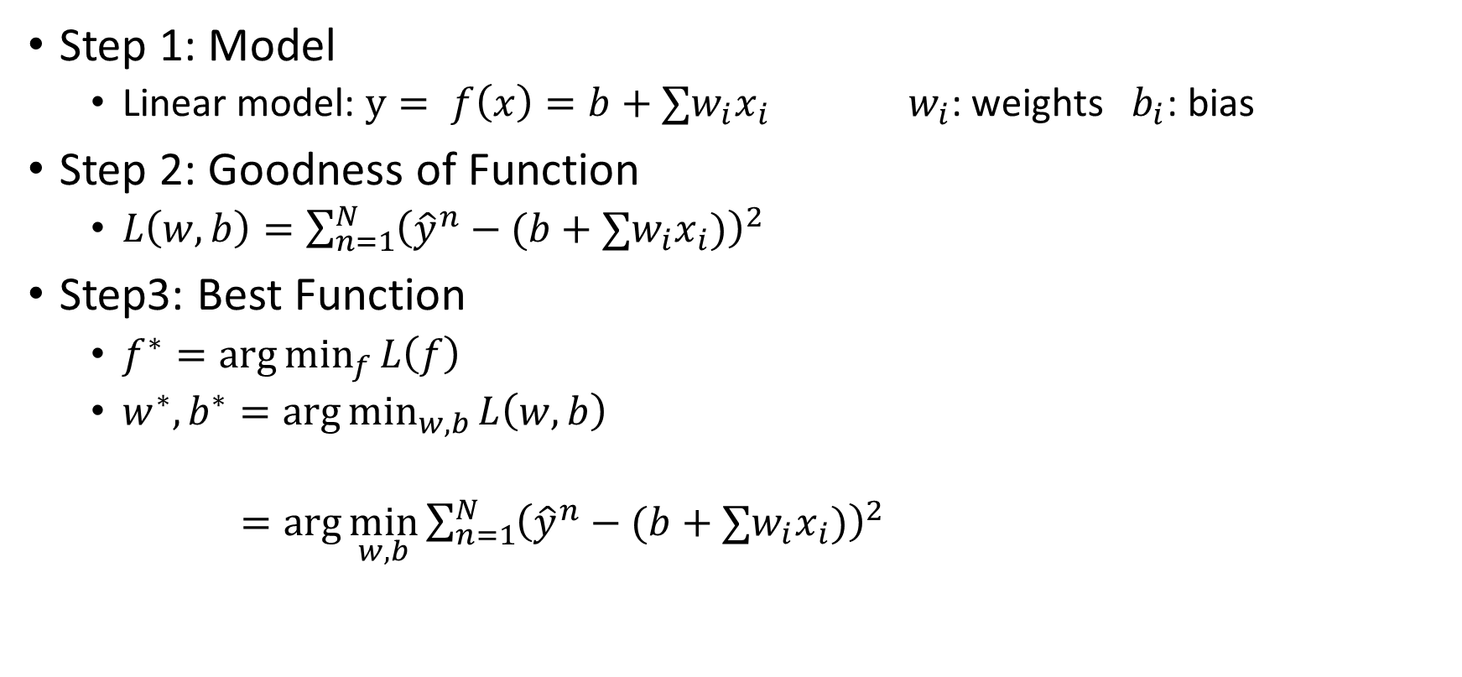
Linear Regression
Step 1: Model
Linear model: $y= f\left(x\right)=b+∑w_{i}x_{i}$ $w_{i}$: weights $b_{i}$: bias
Step 2: Goodness of Function
$L\left(w, b\right)=\sum_{n=1}^{N}{{\left({\hat{y}}^{n}−(b+∑w_{i}x_{i})\right)}^{2}}$
Step3: Best Function
$f^{∗}=\arg{\min_{f}{L\left(f\right)}}$
$w^{∗},b^{∗}=\arg{\min_{w, b}{L\left(w, b\right)}}$
$=\arg{\min_{w, b}{\sum_{n=1}^{N}{{\left({\hat{y}}^{n}−(b+∑w_{i}x_{i})\right)}^{2}}}}$
Gradient Descent

